Slide 1

Defect mass in Test Strategy

Slide 2

Agenda
Moment zero
The chaos 1-3
Quality questions
Structure & Formulas

Slide 3

Moment zero
A product/company bought 7 years ago from Germany
In the first year the support is moved in Bucharest, Berlin team is dismissed
In the second year the RnD team is moved to Bucharest, Berlin team is dismissed
No clear & strong path to absorb the new project in the company ecosystem

Slide 4


The chaos- part 1
Context: Started to manage a new project which needed to become from a monolith to a cloud ready application
Problems:
150+ internal defects
60+ customer defects
1000+ tests
no clear architecture map

Slide 5

The chaos- part 2
Problems:
Few knowledge over the product in Bucharest
8 people team from which 4 of them left in the first month
QA team vanished ( 3 people left in the first month)
Low spirit in the team

Slide 6

The chaos- part 3
Strong Parts:
Tons of documentation
QMS process in place ( Jira, QC ALM, Jenkins)
Support team locally ( in Bucharest)

Slide 7

Questions
https://www.mentimeter.com/s/c3cc8341f5e88d44f4c5eb0e0e727648/cf1fa786c67c

Slide 8
Quality questions
how can we find the most impacted areas by our developments for a milestone/service?
how many tests should we run for each impacted area?
if I have automated test, shall I run manual also?
are our tests focused on the right component?

Slide 9
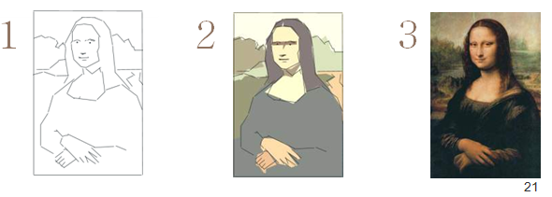
Align all data under the same umbrella
Export data from HP ALM Quality Center to Zephyr
All tests & Defects and US were moved under the right component
Complete the priority field for each test
Establish the mass for each item:
Epics– 10 points
Blocking incident- 10 points
Major incident- 5 points
Minor incident – 1 point
Notes:
What we have till this point:
All the data structured so we are able to see on each component how many US & incidents are and how many test ( manual & automated)
Why Epics and not user stories

Slide 10
Structure the data …in excel
Total mass & mass on the impacted features
Established an auto threshold ( 0.3)
Create a weighted average using the following formula:
(Component Mass * Capacity per day* Number of days)/ Total mass
– rounded to 0 decimals
Notes:
What we have till this point:
- All the data structured so we are able to see on each component how many US & incidents are and how many test ( manual & automated)

Slide 11
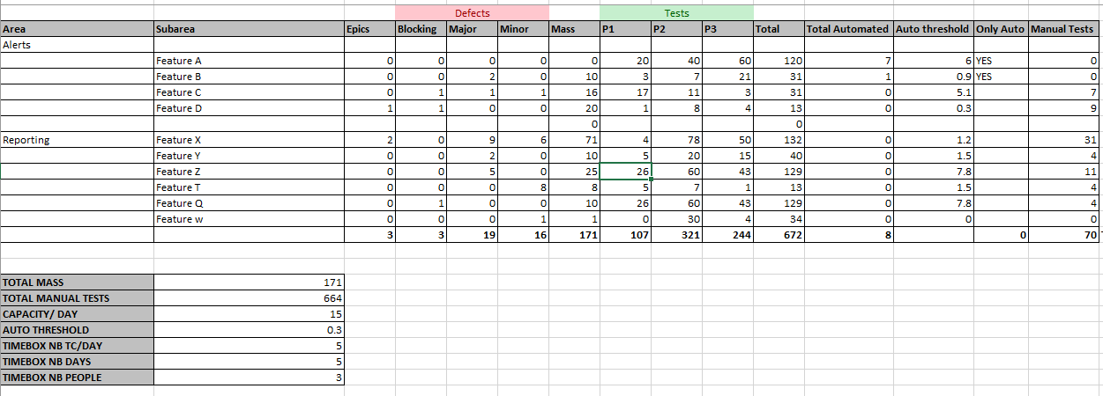
Excel presentation

Slide 12
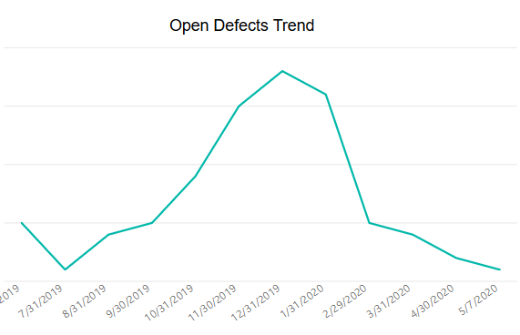
Impact on customer defects
Defect mass implementation
Joined the team

Slide 13
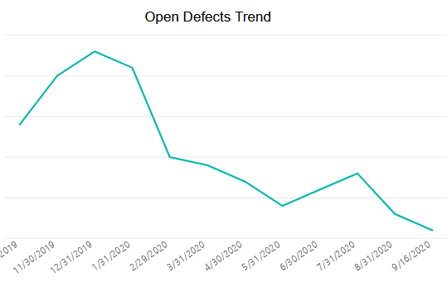
Impact on customer defects
Defect mass implementation

Slide 14

Take Away
https://github.com/vionascu/DefectMass

Slide 15


